Slide 1
IBM Emptoris Virtual Supply Master Refresher Session : How to... Preparation for v10.0.1 Walter Krupinski Senior Product Manager

Slide 2
Agenda
Category language enablement
Currency enablement
How to create additional reference data
Country & State
Mastering rules, with condition etc.
Navigating data source & master records
How to master a supplier
System import utility to import templates, roles, workflows, etc.
How to create template definitions for import
Details on how import works, errors etc.
Show examples on import process (category, user, supplier)
Show groups & roles and its association with user
Show user-category, user-organization association

Slide 3
1. Category Language Enablement
How to…

Slide 4
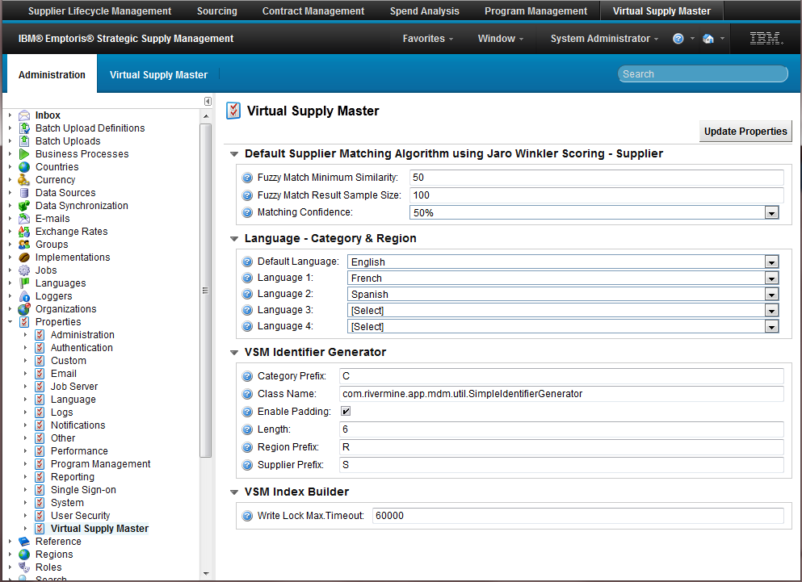
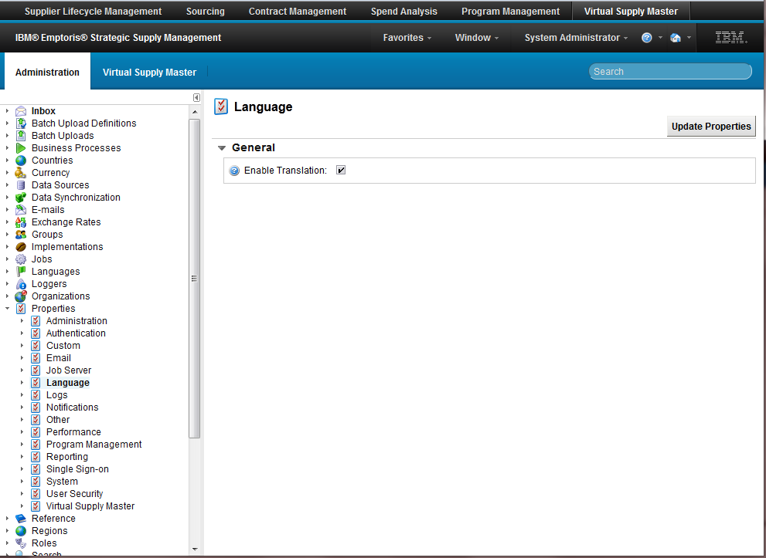
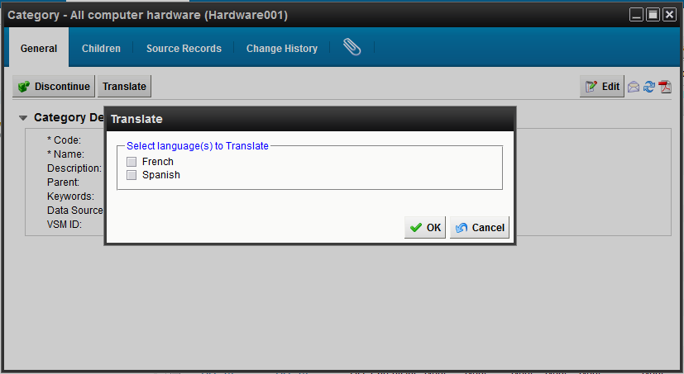
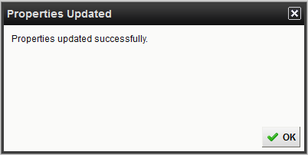
Language Enablement – How to… Enable Category Translations
To enable the category and region translation feature
Navigate –
Administration
Properties
Language
Check Enable Translation
Click Update Properties
Navigate –
Administration
Properties
Virtual Supply Master
FYI – Once a language is enabled, it cannot be changed (known issue)
FYI – Only enabled languages are selectable
FYI – Translations are applied to SLM and Sourcing

Slide 5
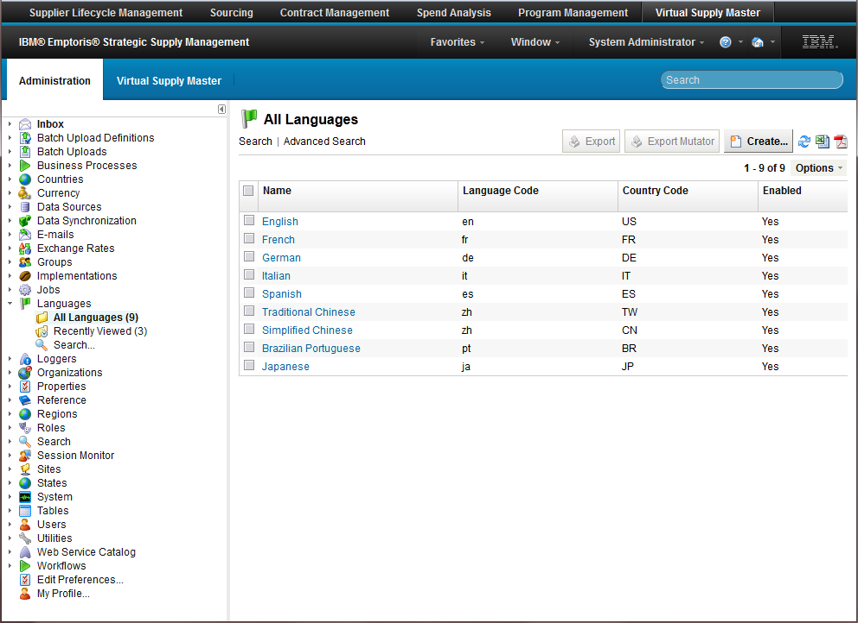
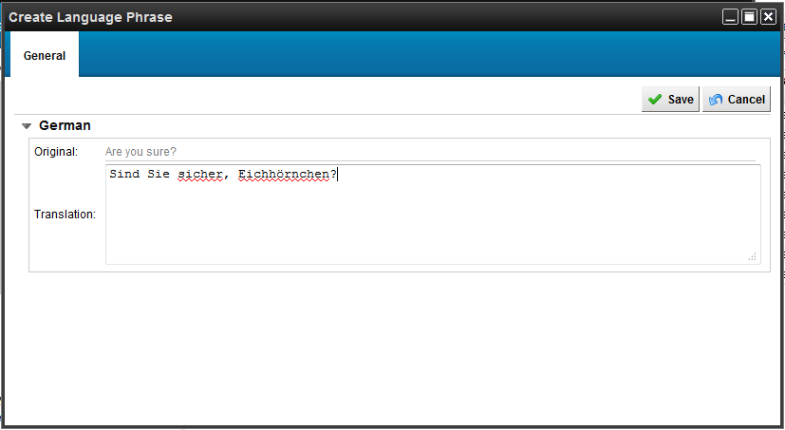
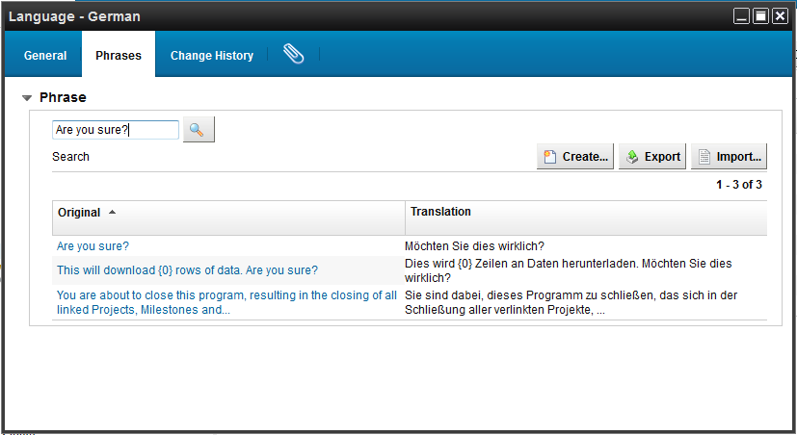
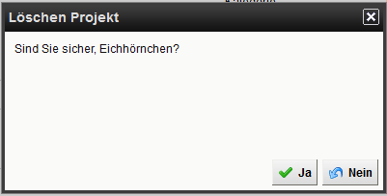
Language Enablement – How to… Edit Specific VSM/PgM Phrases
To edit the text of a particular language
Adjust a translation…
Navigate –
Administration
Languages
All Languages
Select the desired language
General tab
Search for the desired text and click
Edit the phrase and save
FYI – Phrases only impact VSM / PGM
FYI – Not all phrases are editable, even though the system allows it (verify after editing)

Slide 6
2. Currency Enablement
How to…

Slide 7
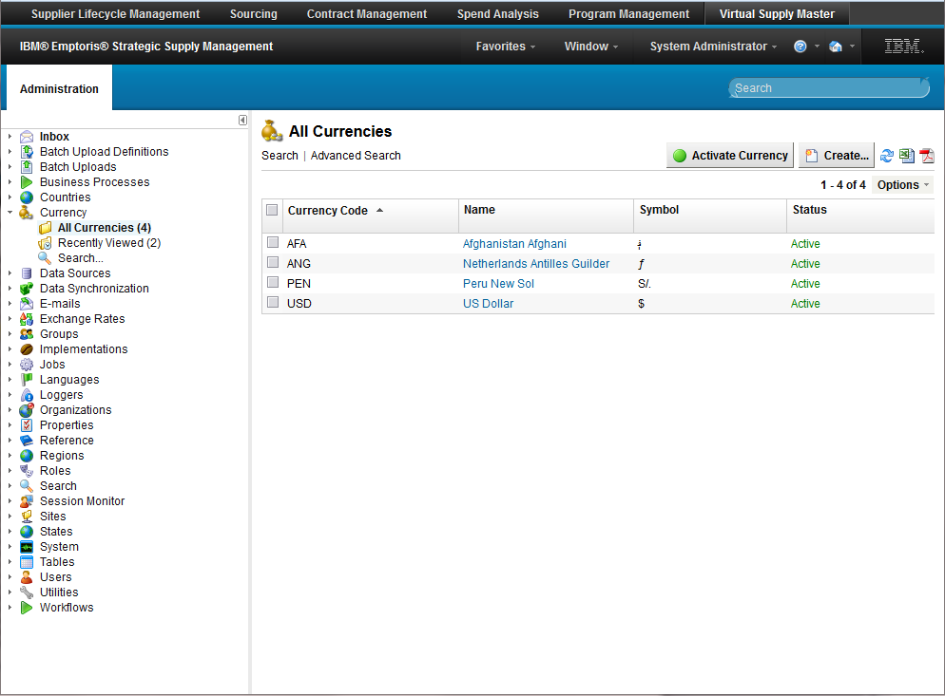
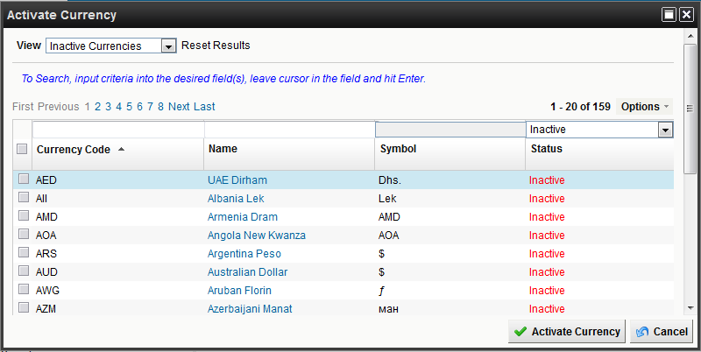
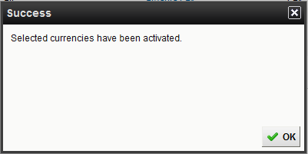
Currencies – How to… Activate a Currency
For customers who want to expand their currency selections for user preferences (and PGM) on the platform
THIS DOES NOT IMPACT THE OTHER APPLICATIONS, ORGANIZATIONS, ETC.
Navigate –
Administration
Currency
All Currencies
Click Activate Currency
Search for desired currency
Select one or more currencies
Click Activate Currency

Slide 8
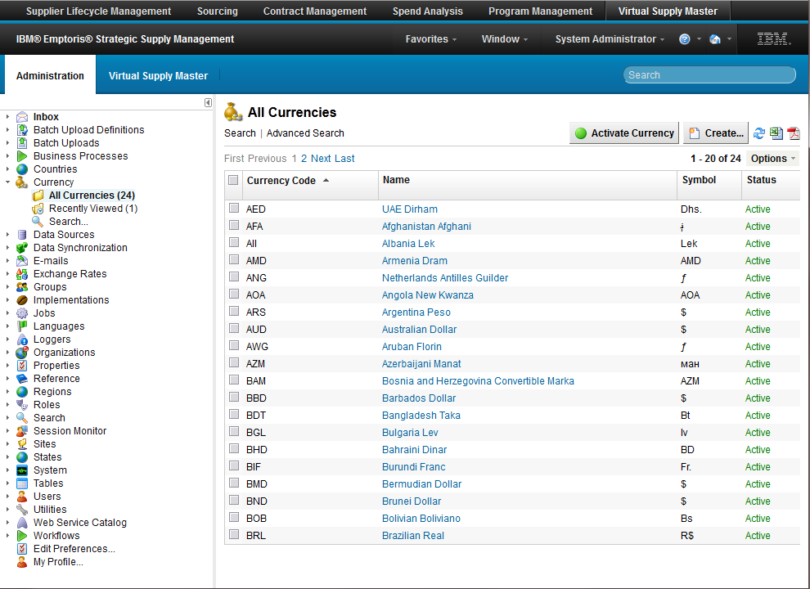
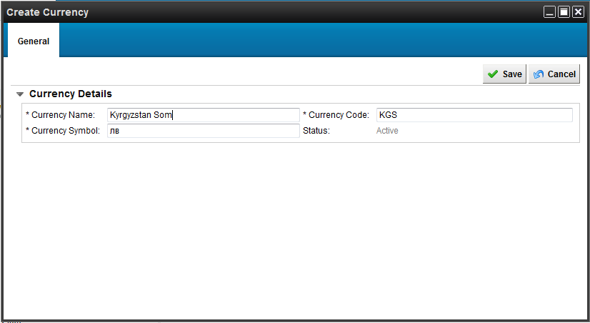
Currencies – How to… Create a Currency
For customers who want to narrow or expand their currency selection for user preferences (and PGM) on the platform
THIS DOES NOT IMPACT THE OTHER APPLICATIONS, ORGANIZATIONS, ETC.
Navigate –
Administration
Currency
All Currencies
Click Create…
Enter Currency…
Name
Code
Symbol
Save
Edit to change the status
Active – selectable
Inactive – not selectable
FYI – There are no OOTB currencies in the platform
FYI – Once a currency is created, it cannot be deleted
FYI – System default currency is set through a startup configuration property

Slide 9
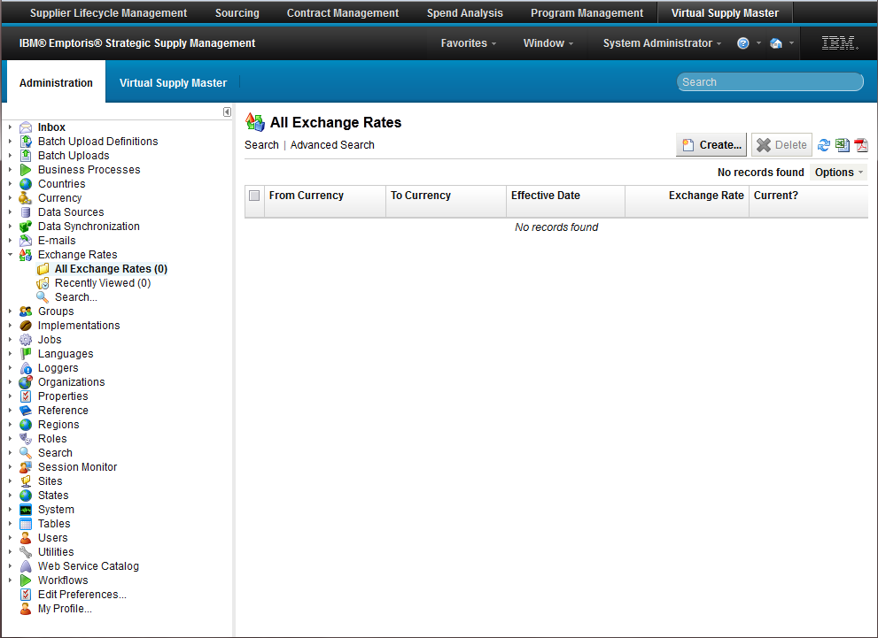
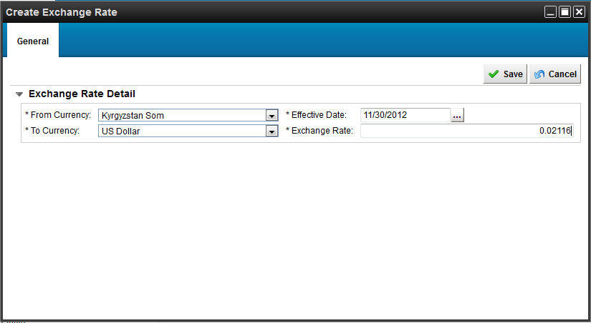
Currencies – How to… Enter Exchange Rates
For customers of Program Management who want to utilize multi-currency and conversions (reports, savings)
DOES NOT IMPACT OTHER APPLICATIONS
Navigate –
Administration
Exchange Rates
All Exchange Rates
Click Create…
Select / Enter
From Currency
To Currency
Effective Date
Exchange Rate
Save
Edit to change the rate
FYI – Effective date is only informational
Next effective date is not taken into consideration (bug)
Duplicate conversions (bug)
FYI – The inverse conversion must be created, otherwise, 1 is assumed
FYI – The inverse is not automatically calculated

Slide 10
3. Reference Data Enablement
How to…

Slide 11
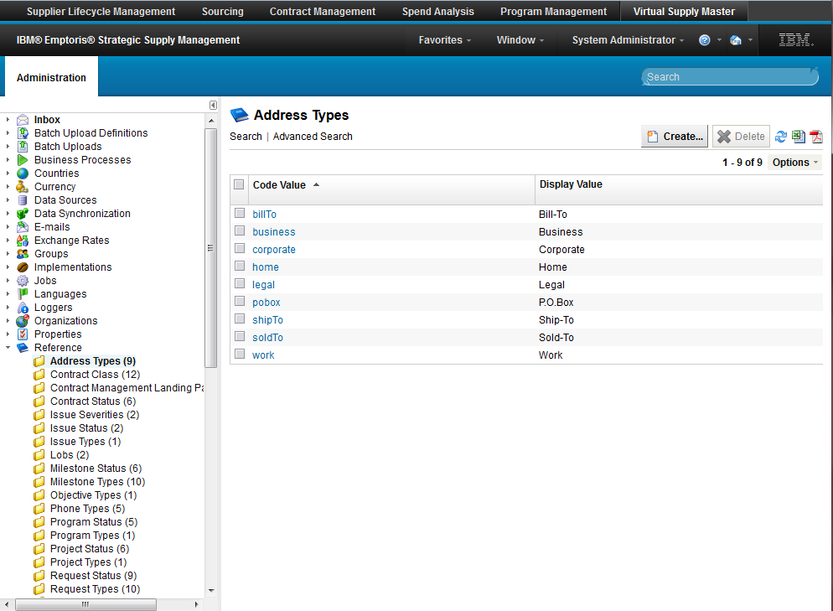
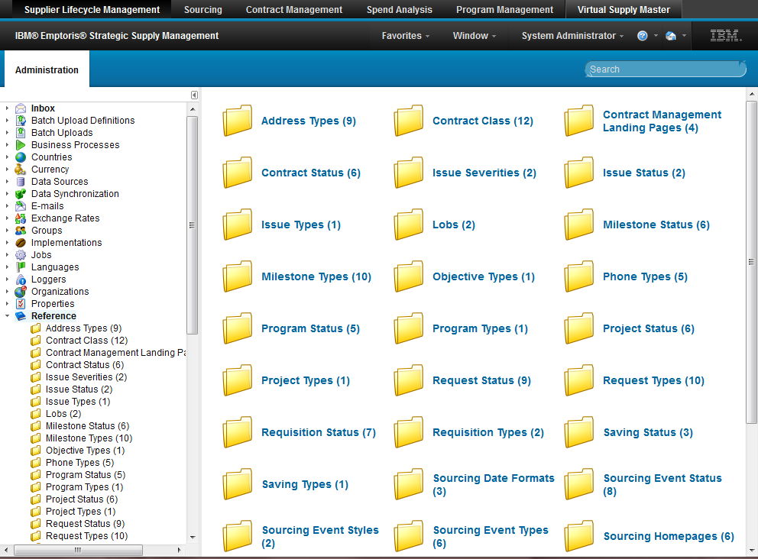
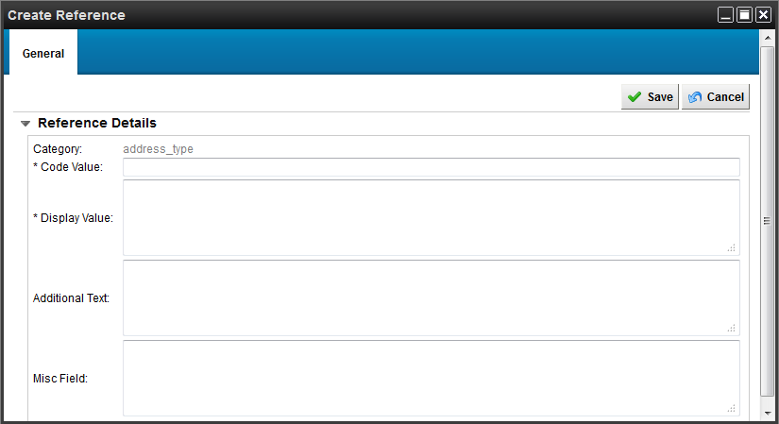
Reference Data – How to… Create a new reference
For customers that are looking for an additional selection of types
For Phone, Address, Business, Request, Program, Project, Task, Objective, Saving and Issue
Navigate –
Administration
Reference
Select the desired reference folder
Click “Create…”
Enter required code and display values
Code value is what is saved in the database
Display value is what is displayed in the UI
Can be translated

Slide 12
4. Country & State Creation
How to…

Slide 13
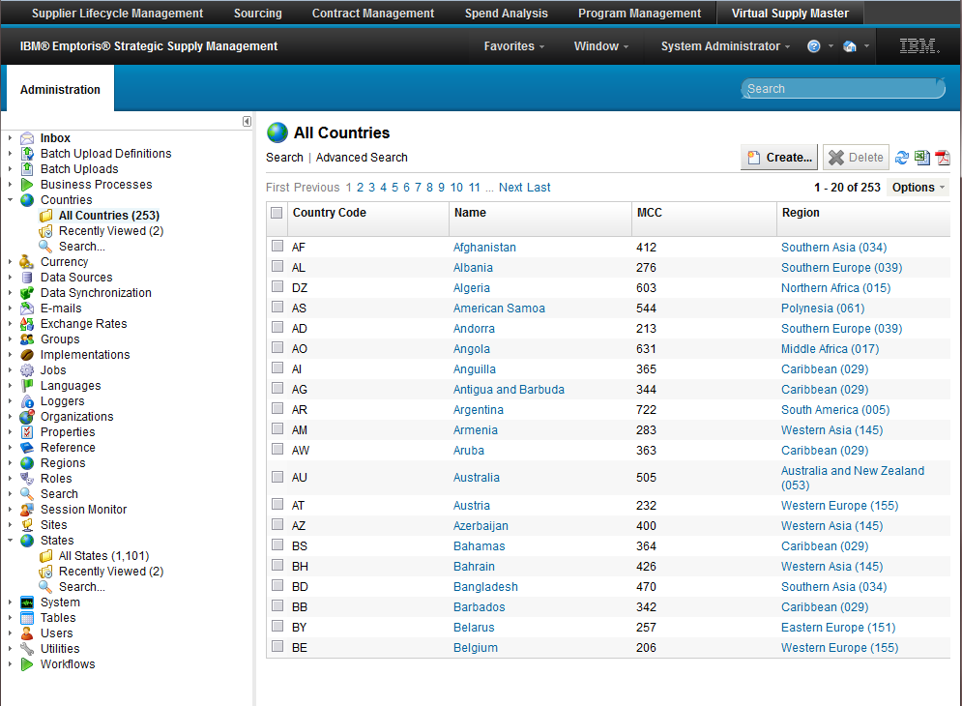
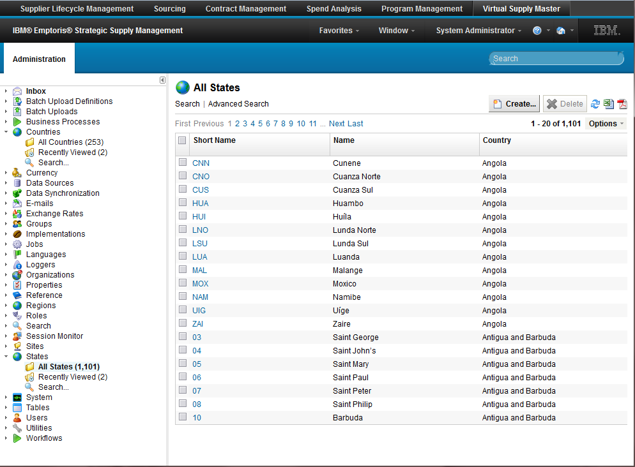
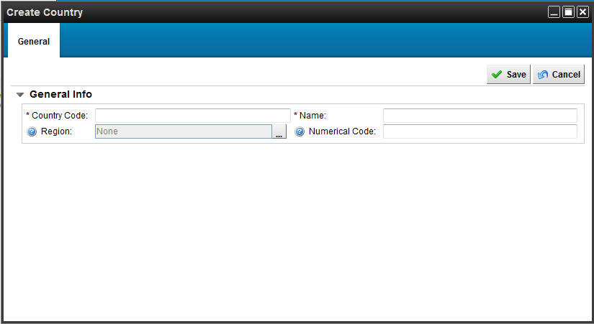

Reference Data – How to… Create a new state or country
For customers that want to add a new state or country
Navigate –
Administration
State / Country
All folder
Click “Create…”
For States – Enter the required Short Name, Name and select Country
For Countries – Enter the required Country Code and Name
A region can be selected to have the country reside in, but not required
FYI – Deletion of a record cannot be restored or reused
FYI – Cannot reactive

Slide 14
5. Mastering Rules
How to…

Slide 15
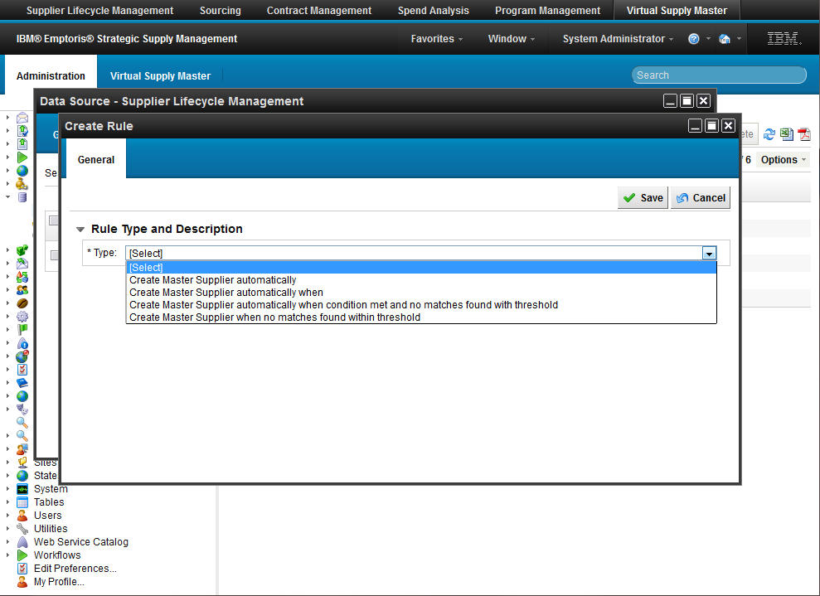
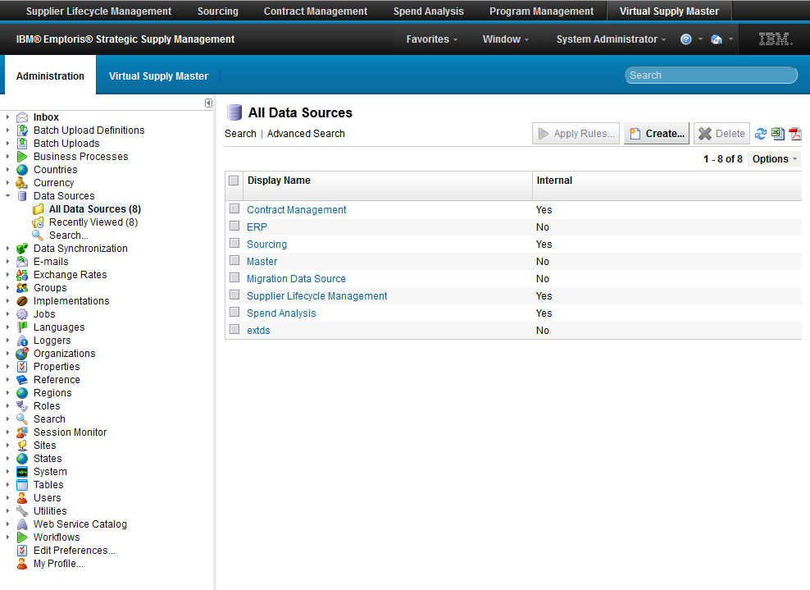
Mastering Rules – How to… Setup an Auto Master Rule
For customers who will have a data source that will feed the VSM records and not always need a Data Steward to manage
E.g. SLM data feeds everything
Navigate –
Administration
Data Sources
All Data Sources
Select the desired Data Source
Rules tab
Create…
Select appropriate rule
Save
FYI – You can Enable / Disable rules
FYI – You can enable multiple rules
FYI – You can “Apply Rules” – Run your rule on the entire data source

Slide 16
Mastering Rules – How to… Setup an Auto Master Rule
Option 1 : Create Master Supplier Automatically
When a supplier registers and is cleared in SLM, the record is pushed to VSM. When a client enables this automation functionality, upon receipt of the record in VSM, the system will automatically create a master record
“Set it and forget it” rule where a customer may have one application designated as a trusted system (SLM)

Slide 17
Mastering Rules – How to… Setup an Auto Master Rule
Option 2 : Create Master Supplier Automatically when (The condition for this rule needs to be specified)
During configuration of VSM, data source rules can be defined to automate the vendor mastering process. For example, rules could be established to automatically master a record when a golden field value is populated and / or equals "X." Multiple rules can be defined.
When a supplier registers and is cleared in SLM, the record is pushed to VSM. When a client enabled this automation functionality, upon receipt of the record in VSM, the system will automatically create a master record when the condition(s) is met. For example, let's pretend that a customer enables auto mastering when the supplier DUNS number is not empty. Therefore, if a supplier record is entered into the VSM and a DUNS number has been entered, the record automatically gets mastered.

Slide 18
Mastering Rules – How to… Setup an Auto Master Rule
Option 3 : Auto Master When a Closest Match Score is Achieved
When a supplier registers and is cleared in SLM, the record is pushed to VSM. When a client enabled this automation functionality, upon receipt of the record in VSM, the VSM will search the existing supplier records for a "closest match" based on the supplier name. While searching for a match, the VSM will return a score. The score represents the percentage likelihood of a match. The closer the score is to 0%, the greater the degree of confidence that a match does not exist.
Depending upon the supplier score, the system will operate as follows:
If the score is between 0% and 50%, a master record will be automatically created.
If the score is greater than 50%, the VSM could do one of the following:
Indicate the record is a duplicate of an existing supplier record. The supplier record remains in the data base in an un-mastered active status.
Automatically link to the closest supplier match master record.
Do nothing or Do nothing with workflow (only if a workflow is active)
For example, a workflow can be defined to send a notification to the supplier registrar and the VSM data steward notifying both parties that a record has been entered the VSM and needs to be mastered. This creates awareness to the data steward that action is required. Additional notifications can be included in the workflow that will send notifications to both parties when the supplier is mastered

Slide 19
Mastering Rules – How to… Setup an Auto Master Rule
Option 4: Combination of Option 2 and 3
When a supplier registers and is cleared in SLM, the record is pushed to VSM. When a client enables this automation functionality, upon receipt of the record in VSM, the VSM will search the existing supplier records based on the conditional rules and "closest match" processes.

Slide 20
6. Navigating Supplier Records
How to…

Slide 21

Demonstration

Slide 22
7. Master a Supplier
How to…

Slide 23
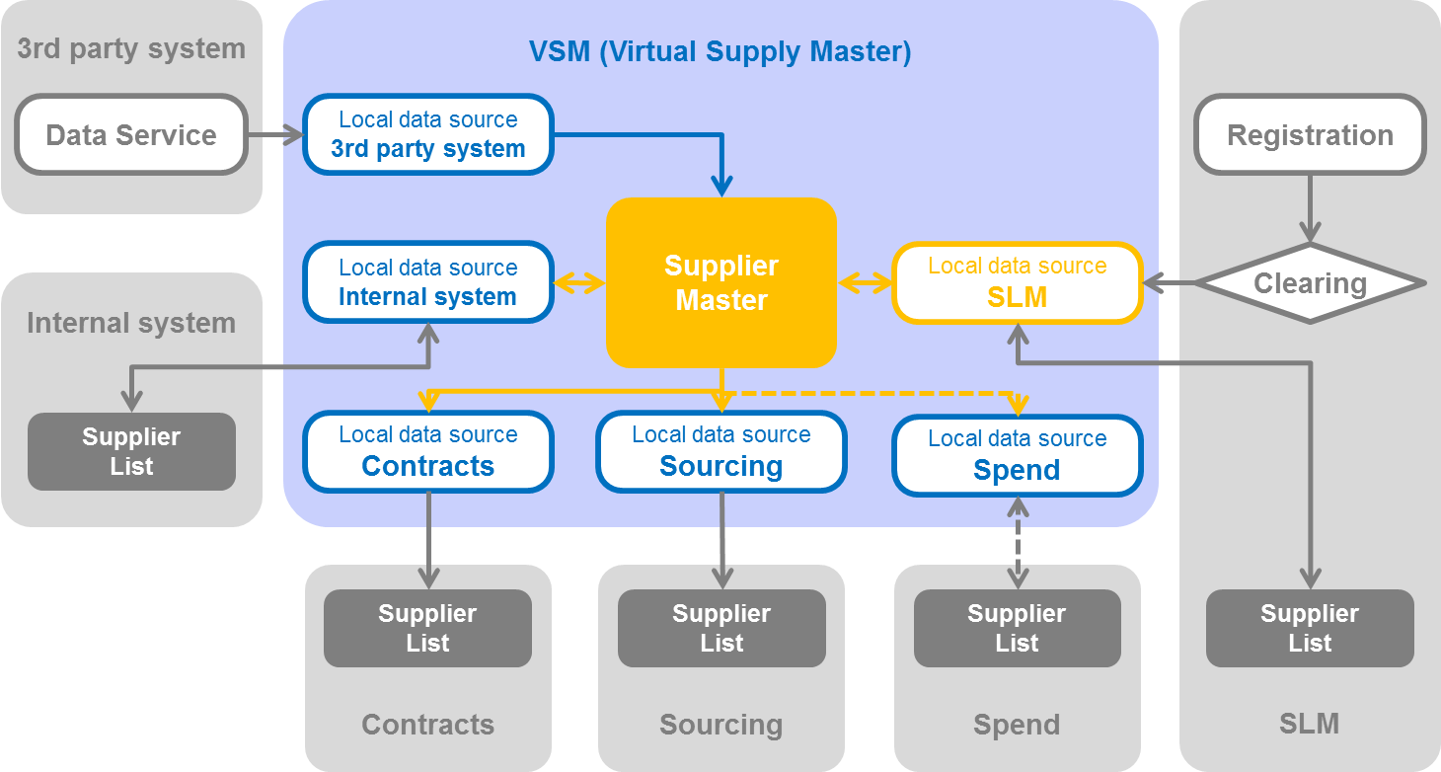


VSM – How to… Master a Supplier
Why Master with one record:
Do this so that the same record is sent to all the applications where it doesn’t exist
Create a master record from one un-mastered source record
Create a record in each data source
Each record is linked to the same master
Occurs manually or automatically
The record contains the pre-defined list of “Golden Attributes”
Replicated in all attached applications (see attached spreadsheet for application details of what fields are replicated)
No ability to add additional replicated attributes
Note
We have the user navigate to the Closest Matches tab during mastering so they are made aware that there are possible closely existing records in the system
DEMO

Slide 24
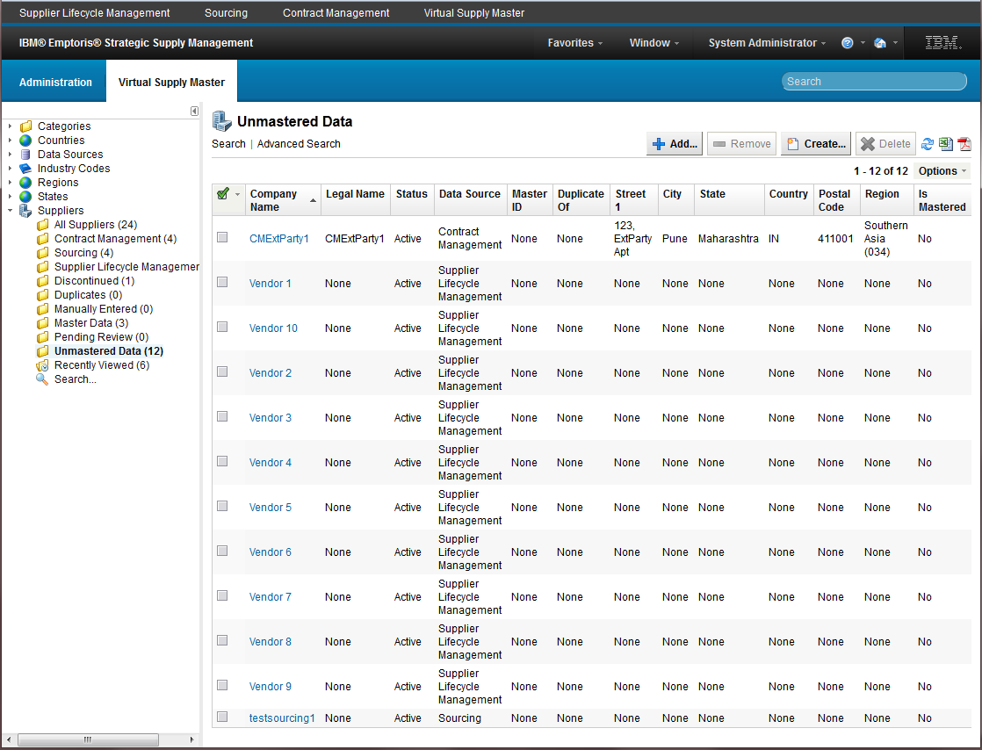
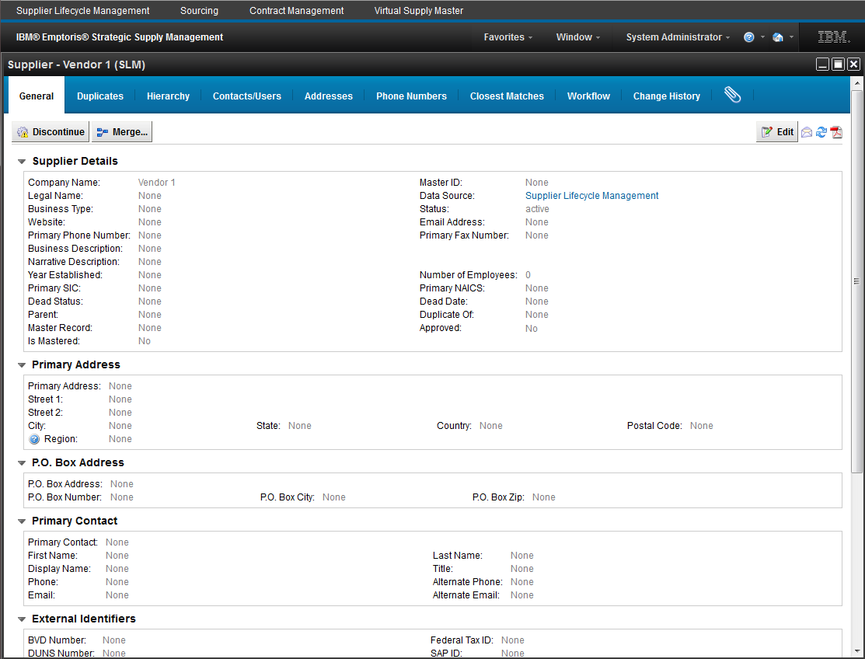
VSM – How to… Master a Supplier
Locate the desired record

Slide 25
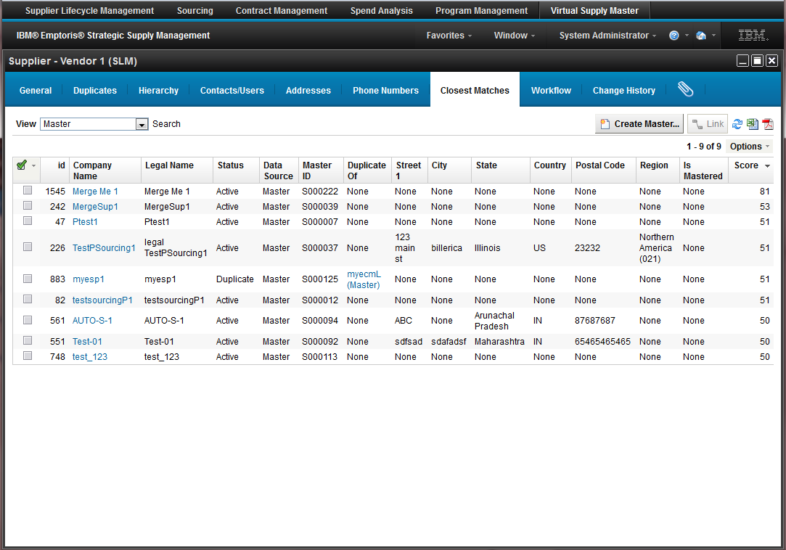
VSM – How to… Master a Supplier
Navigate to the closest matches
Click Create Master… button

Slide 26
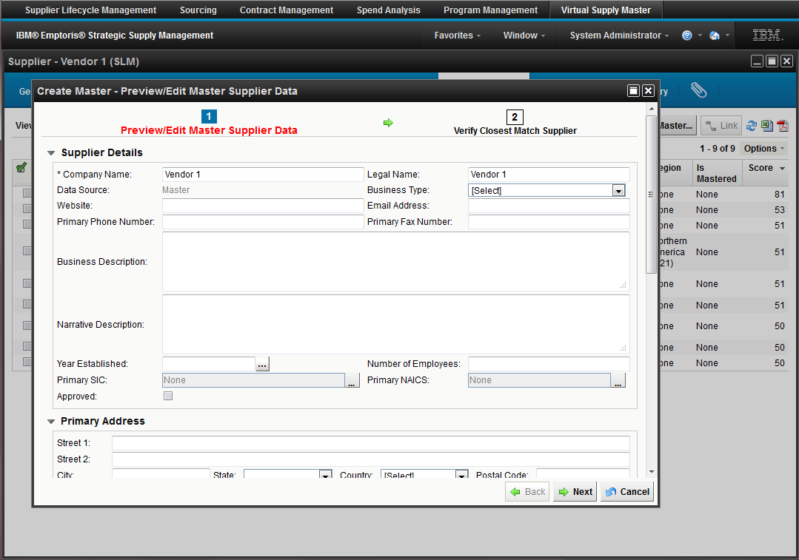
VSM – How to… Master a Supplier
Edit if needed and complete the process

Slide 27
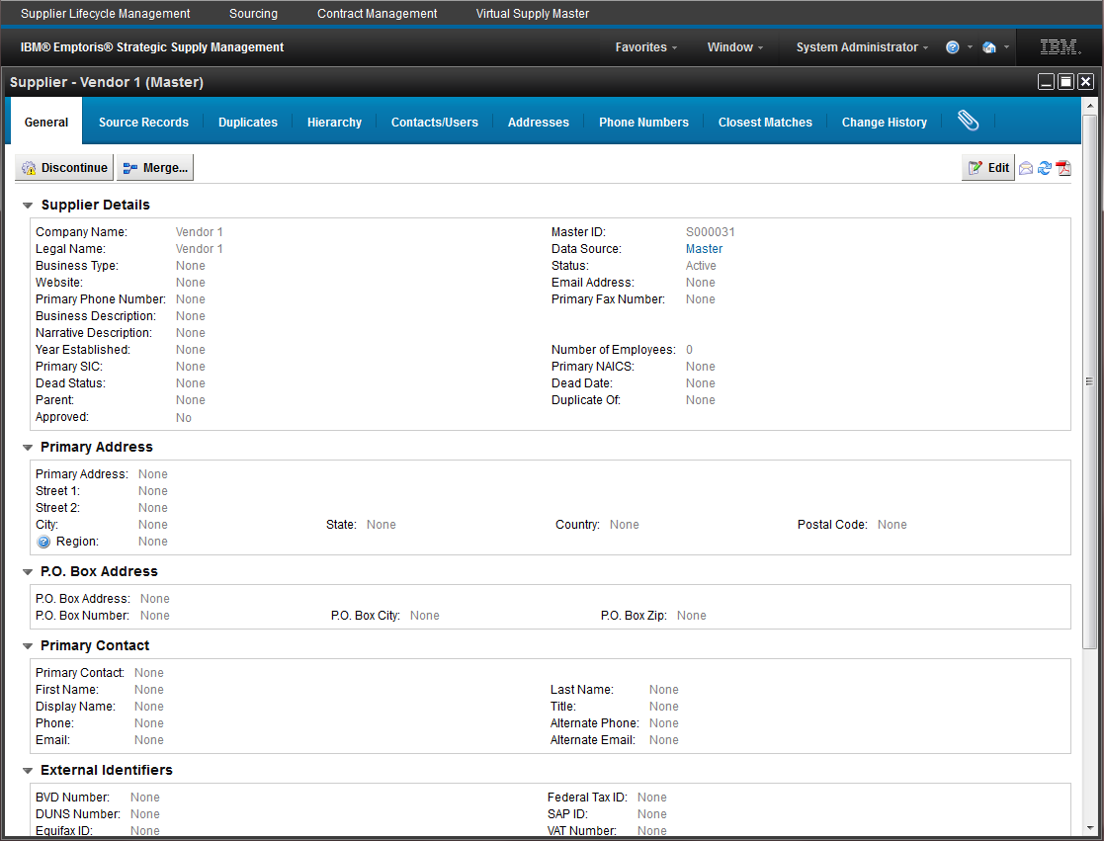
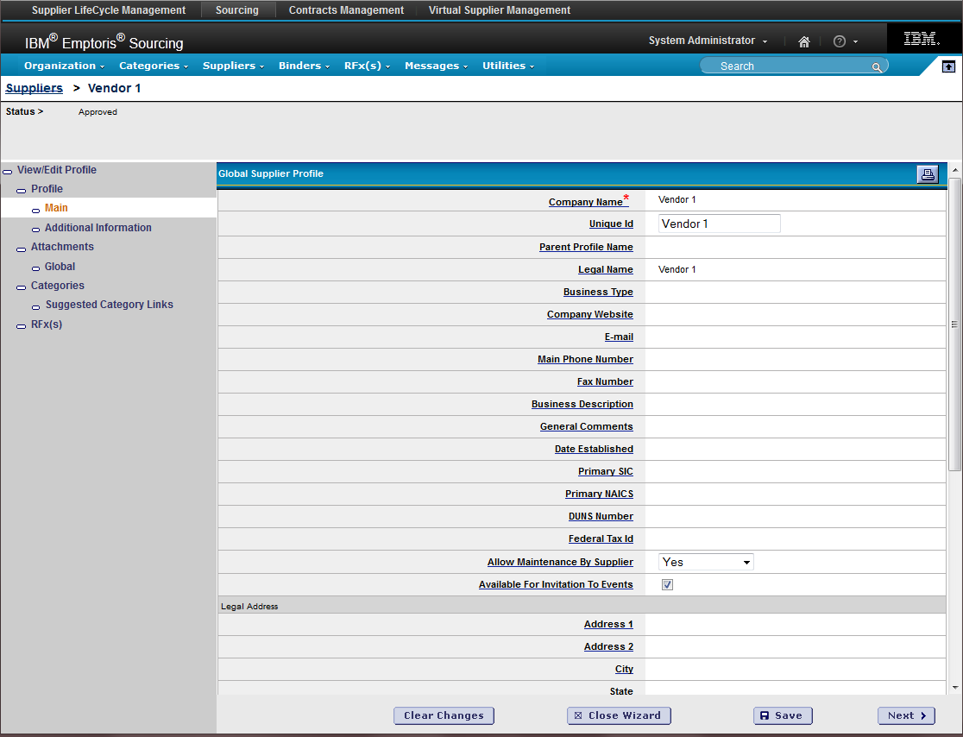
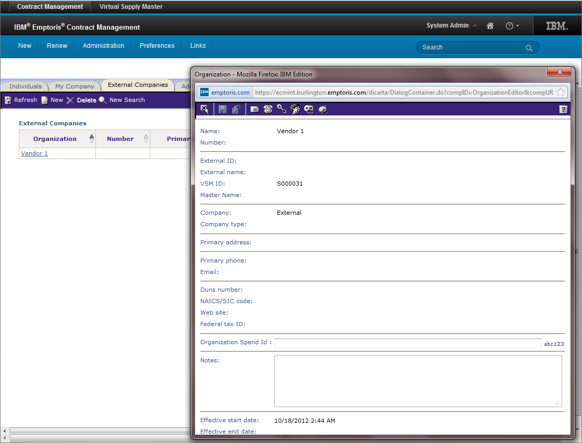
VSM – How to… Master a Supplier
Verify mastered record propagation
Records propagated to applications

Slide 28
8. Use the System Import Utility
How to…

Slide 29
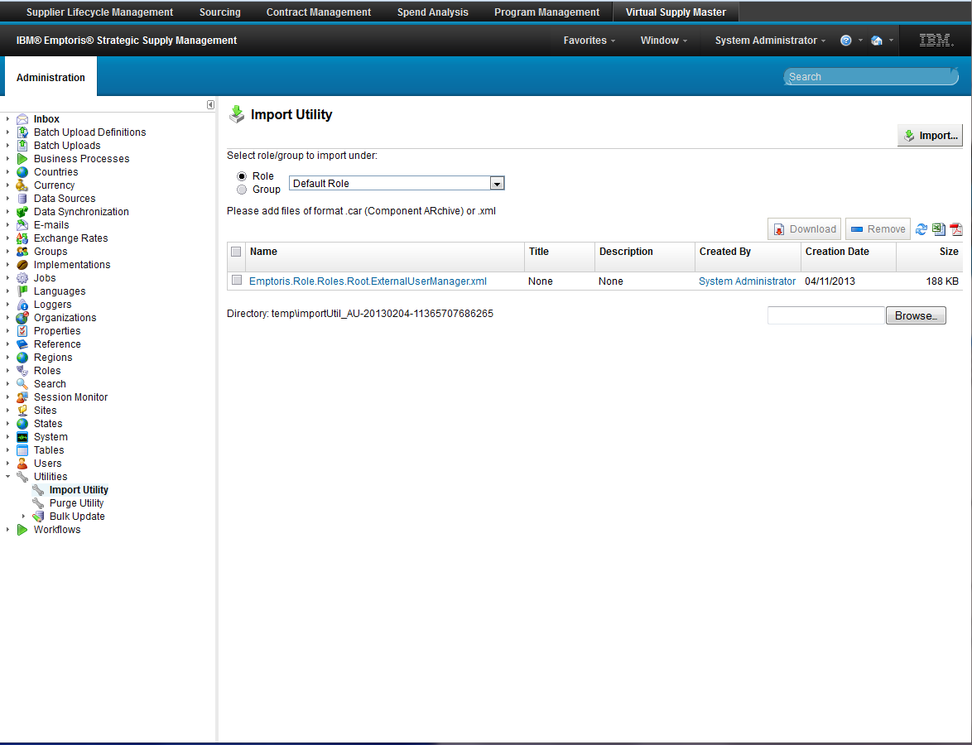
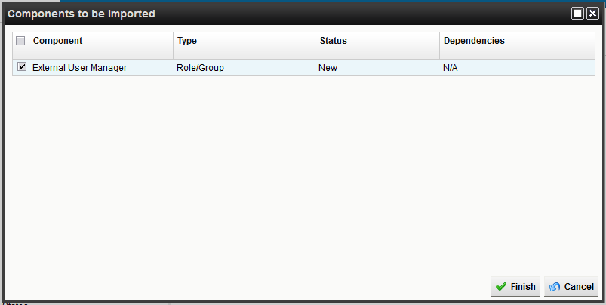
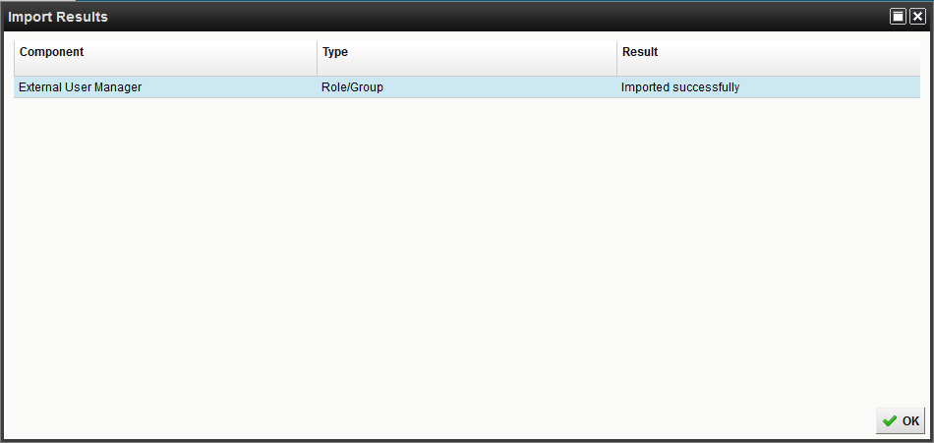
Import Utility – How to… Import
For customers that setup everything on a sandbox and want to transfer items to the new system
Many configurations can be exported and imported
Look for the “Export” button
Exported in XML format
Batch Definitions
Workflows
Roles
Forms
Attributes
DB Columns DO NOT GET exported
As System Admin, navigate
Administration
Utilities
Import Utility
Select “Default Role”
Browse for file, add
Import
Select the component
Finish

Slide 30
9. Create Import Definitions
How to…

Slide 31
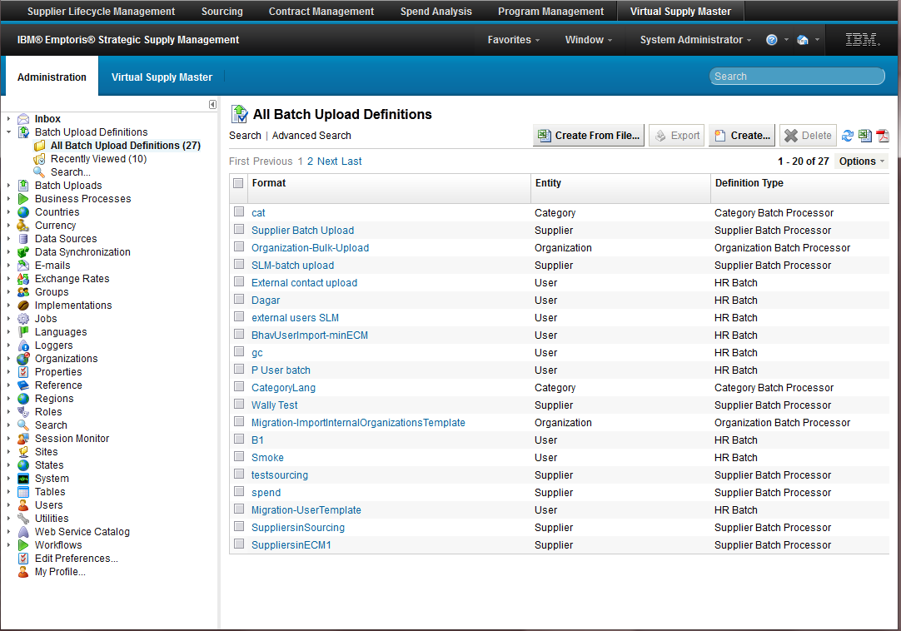
Batch Import – How to… Batch Importing
If you want to import anything into the system, you must create a definition
Navigate –
Administration
Batch Upload Definitions
All Batch Upload Definitions
Create…
FYI – There are no OOTB definitions
FYI - Create From File… doesn’t currently work with non-generic processors – Do not use

Slide 32
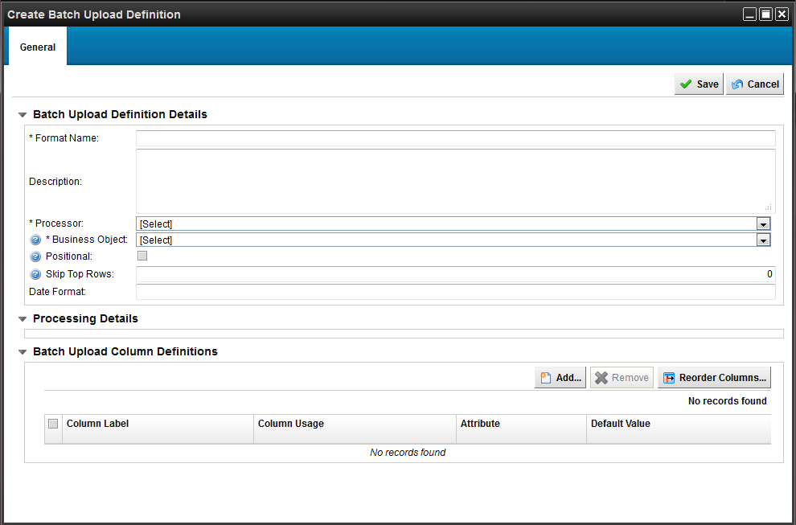
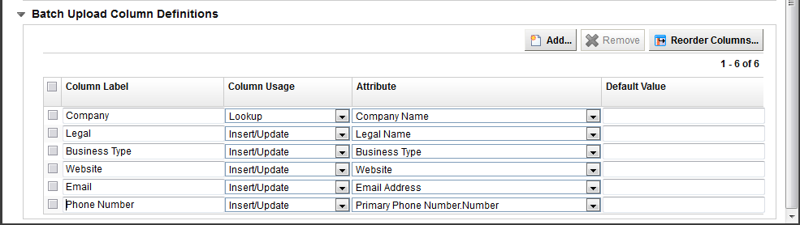
Batch Import – How to… Create Definition
To have the system create a template for you…
Click Create
Enter Required Name
Select the appropriate processor for your purpose
Category
Country
Region
State / Province Subdivision
Organization
Industry Code
HR
Supplier
Select the applicable Data Source
To create a custom template…
Edit column labels, usage and attributes, reorder and remove
Lookup - Use to search uniqueness if it exists and update, otherwise insert
Insert / Update
Ignore
Save
FYI –
Be cognizant of your required fields for an object as the definition creation will not warn you, otherwise the system will throw errors when performing the import with the definition
org.hibernate.exception.ConstraintViolationException: Could not execute JDBC batch update

Slide 33
10. Import Details
How to…

Slide 34
Batch Import – How to… Details
Processors
Engineered to appropriately establish information across multiple objects
Example:
A supplier imported into the system doesn’t only fall into a supplier table
A supplier’s information spans across the tables of
- Supplier Table
- Address Table
- User Table
- Phone Table
- Data Source Table
Error Handling
The system will not fail an entire import
Errors are logged in the UI and available in the attachment tab of the failed import
Adjust errors in file, removing the error column and “reload”

Slide 35
11. Import Process
How to…

Slide 36
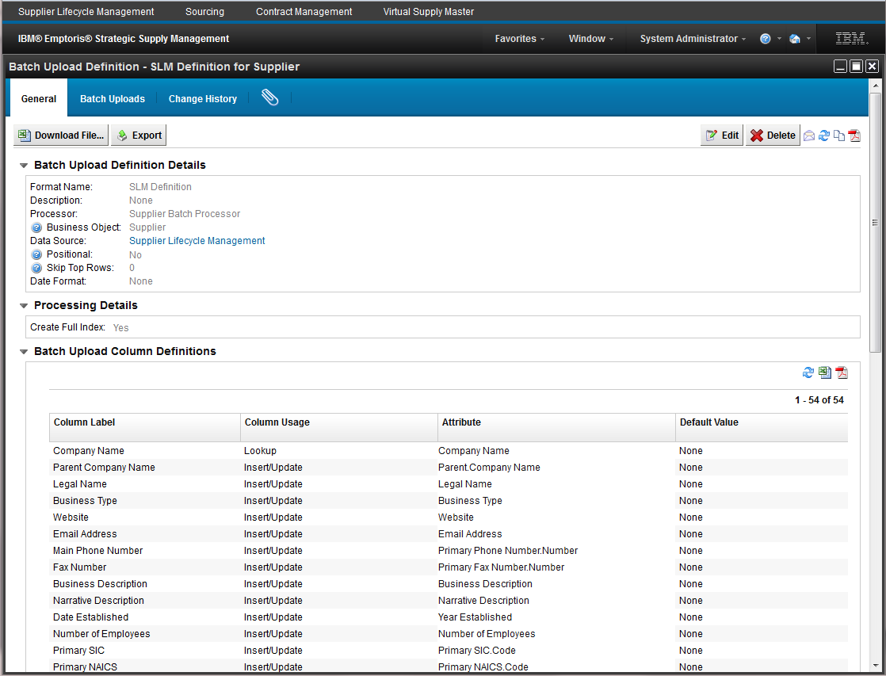
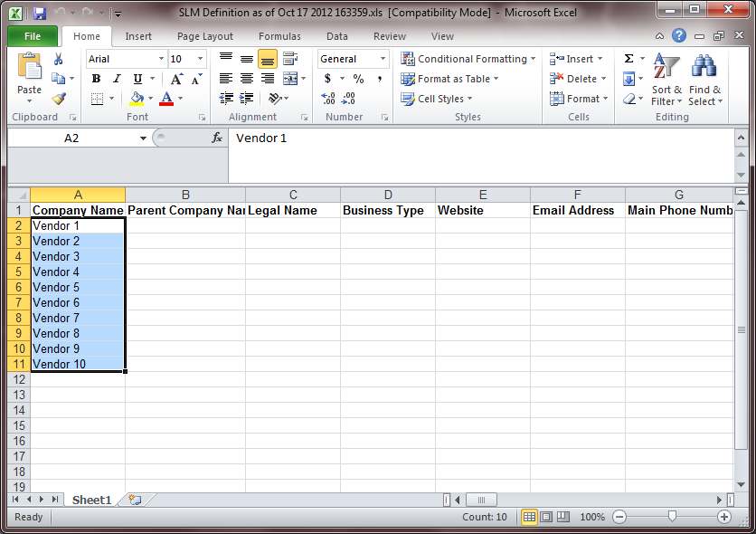
Import Process – How to… Download
From your batch upload definition…
Click
Download File…
Save to local machine
Update your file and save

Slide 37
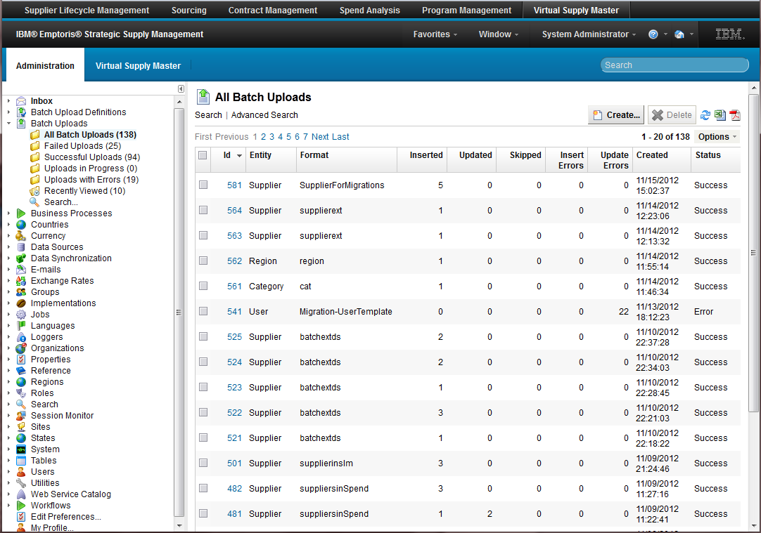
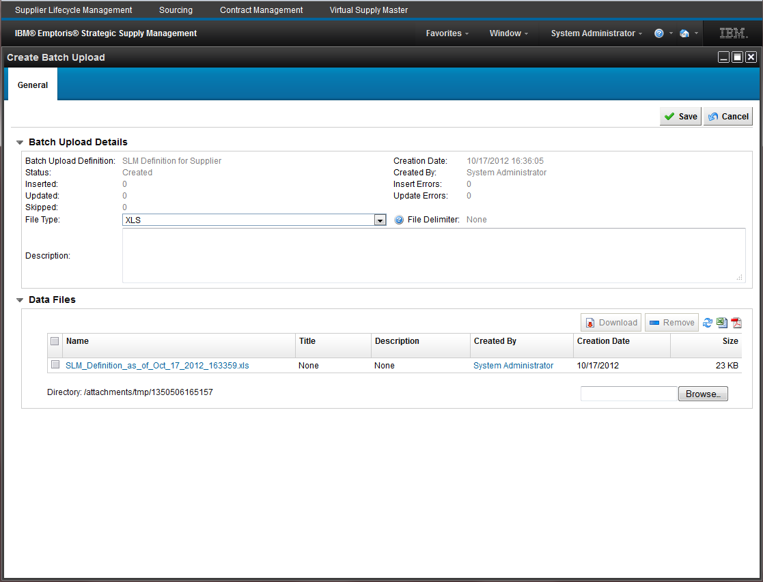
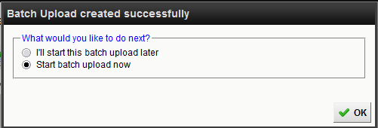
Import Process – How to… Import
Navigate –
Administration
Batch Uploads
All Batch Uploads
Create…
Select the appropriate batch upload definition
Browse…
Your local machine
Save
Schedule to run now or later
Later places the upload in “Created” status

Slide 38
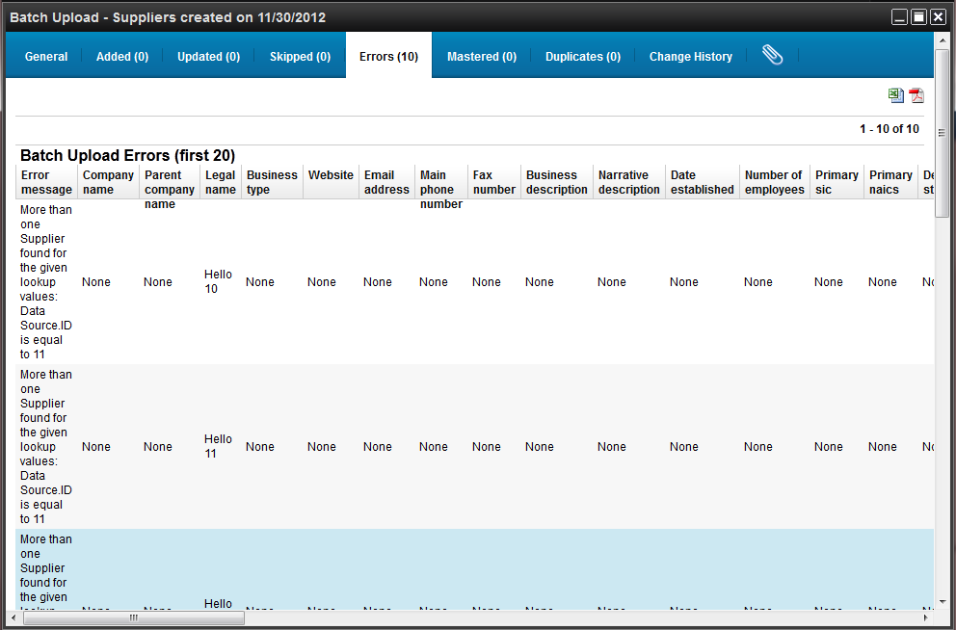
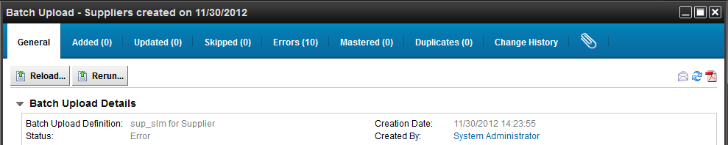
Import Process – How to… Export – Error File and Reload
Navigate to the completed process
Go to Errors tab
Click the spreadsheet icon
Save to local
Delete Error Message column
Fix rows and save
General tab – Reload…
Browse…
Your local machine
Save
Schedule to run now or later
Notes:
You can set up– do a lookup field;
Updates/insert

Slide 39
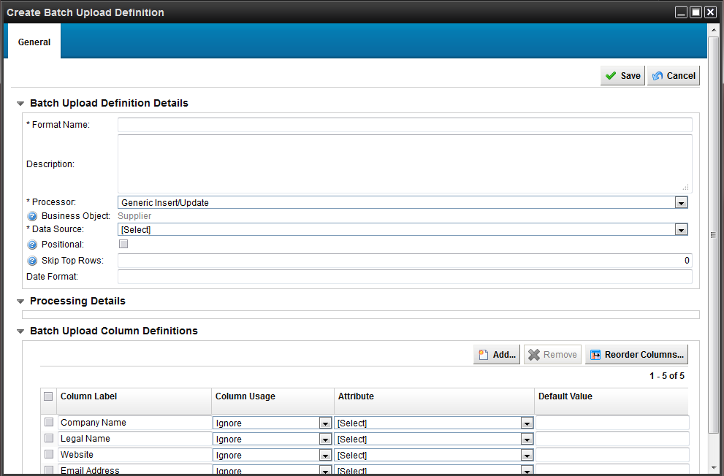
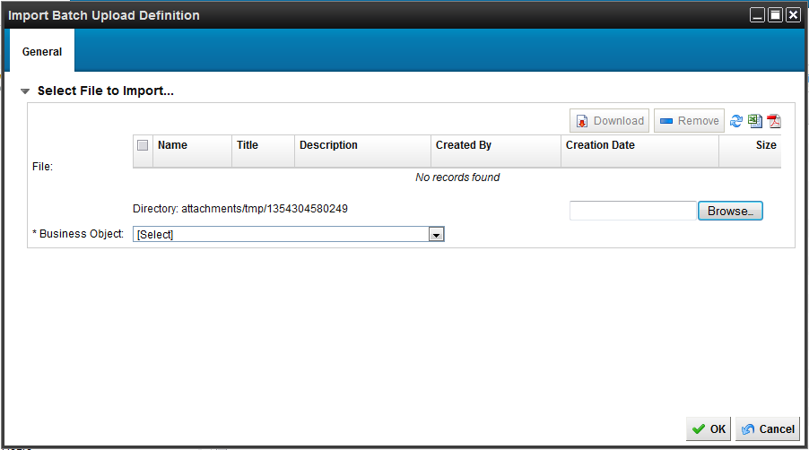
Import Process – How to… Create Definition From File
To have the system create a template for you based off your own file…
Click Create From File…
Browse…
Your local machine
Select the appropriate Business Object
Click OK
Enter Required Name
Select the appropriate processor for your purpose
Select the applicable Data Source
Edit column usage and select mapped attribute
Lookup
Insert / Update
Ignore
Save

Slide 40
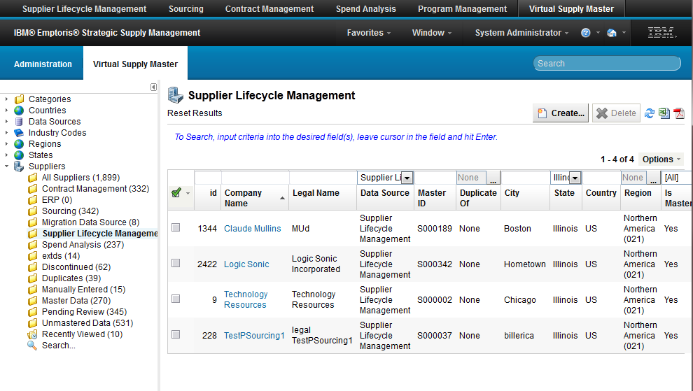
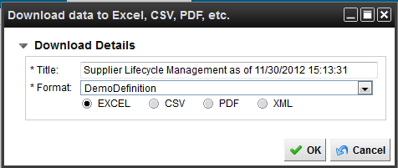
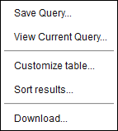
Import Process – How to… Export in defined format
Example :
Update Supplier Records
Navigate to the desired object and perform a search
Options menu
Download…
Rename the file if needed
Select the desired batch definition
Select the format
Save to local
If you saved in XLS format…
Update rows
Perform batch upload steps using same definition
Notes:
You can set up– do a lookup field;
Updates/insert

Slide 41
12. Groups and Roles of Users
How to…

Slide 42
Demonstration

Slide 43
13. Categories and Organizations of Users
How to…

Slide 44
Demonstration

Slide 45
Thank you!
Visit the v10 Community here.
Visit the v10.0.1 Community here.
HR Instruction Files
Walter K. Krupinski Senior Product Manager PMC IBM Industry Solutions
Desk: 1-720-349-1748 E-mail: wkrupins@us.ibm.com
Notes:
Search for tags : vsm, awesomeness, captain, emptoris, management, milestone, program, project, request, task, tennile, pgm, alder, aspen

Slide 46
Hidden Slides
Now begins additional hidden slides that cover (in no particular order)
UI
Searches
Role Queries
Column Configurations
User and Password Settings
Security
Indices
Trusted Attributes
Notifications
Roles
VSM Algorithm Settings

Slide 47
The UI Of the VSM
How to…

Slide 48
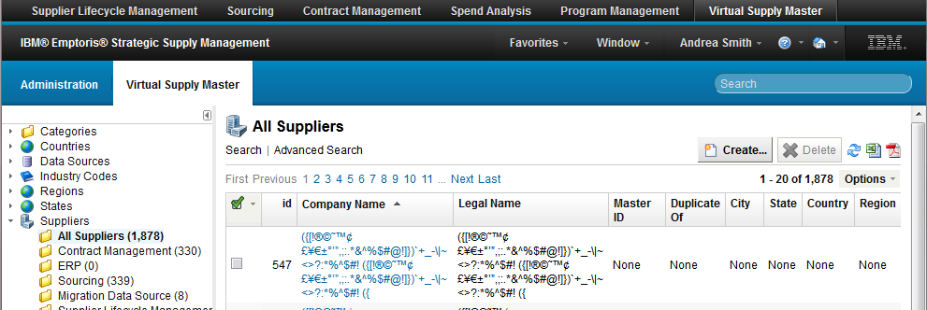


UI – How to… Basic and Advanced Search
For any user…
On list views
Basic
Basic filtering
Displayed columns only
Advanced
Expression based
All available attributes of the object

Slide 49
UI – How to… Basic and Advanced Search
For any user…
On list views
Basic
Basic filtering
Displayed columns only
Advanced
Expression based
All available attributes of the object

Slide 50




UI – How to… Save a Search
For any user…
Perform a search
Options Menu
Save Query…
Enter name
FYI – These are for each user to create and are not shared with others

Slide 51



UI – How to… Delete a Saved Search
For any user…
Go to desired folder
Options menu
Edit Query…
Delete

Slide 52


UI – How to… Create search folder for a role
For a system role…
Navigate –
Administration
Roles
<Role>
Business Objects
<Object>
Queries
Create Query…
Select options
Save Query…
Once saved, you can also Delete
FYI – When a customer wants a standardized filter, do this
FYI –
- Distinct resolves any conflict in roles where cross visibility results in duplicate lines
- Logical deletes are items that have been deleted in the system
- Totals are the folder count

Slide 53



UI – How to… Indices for Platform Search
For the system…
Navigate –
Administration
Search
All Indices
Select desired index to be available for platform search
Click Enable / Disable button
FYI – THESE ARE NOT ENABLED OOTB AND MUST BE ENABLED FOR CLOSEST MATCHES (in release notes)

Slide 54




UI – How to… Configure displayed columns
For any user…
Go to desired folder
Customize table…
Add Column
Select Attribute
Reorder Columns
Revert
Delete Columns
FYI – These are for each user and are not shared
Some users want to see more or less of what is OOTB

Slide 55

UI – How to… Configure columns for a role
For a system role…
Navigate –
Administration
Roles
<Role>
Business Objects
<Object>
Table
Add Column
Select Attribute
Reorder Columns
Delete Column
Export to XML for import in another system
FYI – This only impact users who have not configured their own table columns

Slide 56
User Password Configurations and Notifications
How to…

Slide 57

UI – How to… Configure Security
For login and password configurations…
Navigate –
Administration
Properties
User Security
Adjust items such as:
Login attempts
Password expiration
Password reuse
Password strength
Forgot password feature
Username length

Slide 58




UI – How to… User Notifications
For login and password notification adjustments…
Navigate –
Administration
Properties
Notifications
Click the desired notification component
Edit the desired language’s text
Option
Add an attribute to a notification

Slide 59
Enable Reports Feature on the Platform
How to…

Slide 60

Reports – How to… Enable for the Platform
For customers who want to use the reporting feature of the platform
Program Management reports
User reports
Ad-hoc
Supplier reports
Ad-hoc
Navigate –
Administration
Properties
Reporting
Click Is Clarity Enabled
Update Properties
FYI – This is not enabled OOTB

Slide 61
ROLES
How to…

Slide 62



Roles – How to… Clone a Role
For customers who want to have a custom role for
Program Management
VSM
Navigate –
Administration
Roles
<role>
Clone a role to create a new custom role
Export a role to import in another system
Security…
Set which roles can grant this role
FYI – MOST RESTRICTIVE ROLE WINS
Associate a user to one role for the module

Slide 63


Roles – How to… Edit Object Visibility for a Role
For customers who want to define that custom role
Example: I do not want this role to see the SAP ID on a form
Navigate –
Administration
Roles
Custom Data Observer
Business Objects
Supplier
Forms
SupplierForm
External Identifiers
SAP ID
Uncheck “Allowed”
Apply
FYI – This prevents a user from seeing this field on the form – take it one step further with the next slide

Slide 64




Roles – How to… Edit Object Visibility for a Role
For customers who want to define that custom role
Example: I do not want this role to see the SAP ID anywhere (columns, report)
Navigate –
Administration
Roles
Custom Data Observer
Business Objects
Supplier
Attributes
SAP ID
Uncheck & Save
View
makes it viewable
Edit
makes it editable
Edit All
can be mass updated in UI
Search
can search for it
Sort
can sort it in tables
FYI – This prevents a user from seeing this field ANYWHERE ELSE in the system – cannot select the attribute for columns, no advanced search

Slide 65
Workflow for Mastering
How to…

Slide 66






Workflow – How to… Enable a VSM Workflow
For customers who want to utilize a “Data Steward” to do all mastering utilizing the OOTB sample workflow
Navigate –
Administration
Workflows
Inactive Workflow Definitions
Access “New Supplier Onboarding Workflow”
This is the sample
Click Clone…
Edit name and description
Save
Variable tab (select Data Steward)
Click Default Data Steward
Specify type
user (User) or
a role (Group / Role)
Select value
Save
General Tab
Activate
Just this workflow
OK
FYI – Workflows are a highly configurable feature. Please consult videos on the PGM Community

Slide 67
VSM Setup Trusted Attributes Data sources Auto Master
How to…

Slide 68

VSM Setup – How to… System Algorithm Settings
When customers need to return more results in matches
Navigate –
Administration
Properties
Virtual Supply Master
Minimum Similarity
A value between 0 and 100 to set the minimum required similarity for matching Suppliers. The closer the value is to 100, the more similar the Suppliers are required to be.
Result Sample Size
Maximum fuzzy match samples returned for scoring
Matching Confidence
The percent match confidence that must be scored to be returned on Closest Matches
50% - 100%
FYI – These settings OOTB are very high for narrow closest match results – a must to adjust

Slide 69

VSM Setup – How to… Setup a Data Source
For customers who will expect updates from a source record to be populated to the master
E.g. Publish – pushes to the VSM
E.g. Subscribe – VSM pushes to the source
Navigate –
Administration
Data Sources
All Data Sources
Create…
Enter Name and Display Name
Select Objects
Select Options
Publish
Subscribe
Publish and Subscribe
For Supplier
Select the desired Matching Algorithm (FYI – See next slide)
Select the Unique Attributes
These are the “Lookup” attributes
Save

Slide 70
VSM Setup – How to… Setup a Data Source
A scoring algorithm:
is used to compare company names, e.g. “IBM” and “IBM Corp”
score is normalized (0 no match, 100 perfect match)
selectable for an external data source to utilize when records are introduced into the VSM
Jaro and Jaro-Winkler
Jaro measures the similarity between two strings and scores it
Jaro-Winkler gives a higher scores when matching is found in the first 4 characters
This is the system matching algorithm used by the VSM – cannot be changed
Levenshtein
Measures the difference between two strings and uses the edit distance to score
i.e. the minimum number of edits (in terms of insertions, deletions, substitutions of characters) needed to transform one string to another
"IBM" and "IBM Corp“ - edit distance is 5
5 insertions (space, "C", "o", "r", "p")
Notes:
Core SSM applications only use JaroWinkler
For new data sources – you can choose
We think JaroWinkler is the best
--

Slide 71



VSM Setup – How to… Setup a Trusted Attribute
For customers who will have an external connection of suppliers / categories / regions
E.g. SLM data feeds everything
E.g. Sourcing users update source records
Updates on any of the local source records is propagated to the master record IF :
the data source is set to publish suppliers
the attributes of that source are set to be trusted
Navigate –
Administration
Data Sources
All Data Sources
Data Rules tab
Add Data Rule…
Select Attribute
Select Source(s)
Move
Save
FYI – There are no OOTB Trusted Attributes
FYI – If a customer wants all sources trusted, you will have to trust every single attribute for every single data source

